Slide 1
Trauma & Rehabilitation
By
Sumera sattar
Lecturer Health &Physical Education

Slide 2
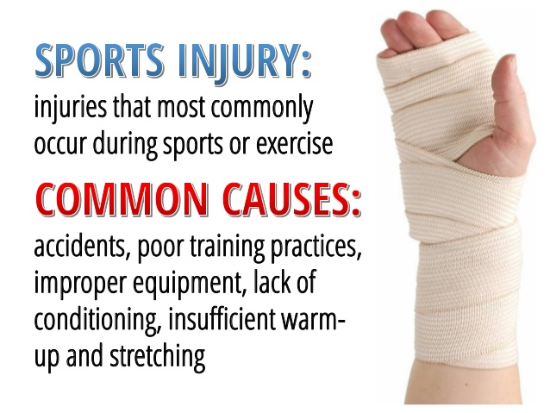

Slide 4
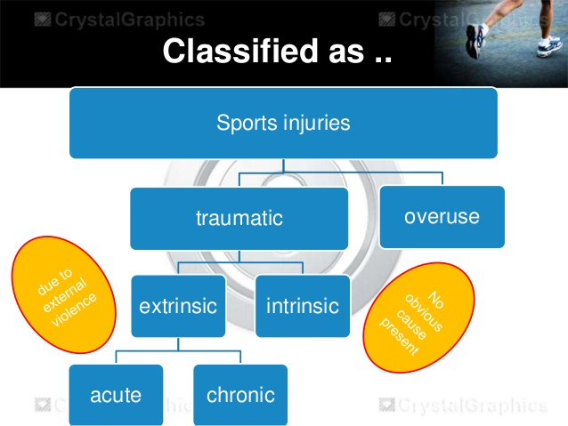

Slide 7
HOW CAN WE REDUCE THE RISK OR HAZARDS?
Health/ Fitness
Skill and technique
Training
hydration
Warm up/ Warm down
Correct clothing and equipment
Correct footwear
No Jewellery
Obeying of the rules

Slide 10
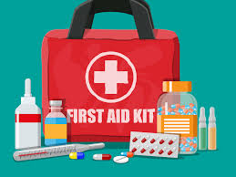
TREATMENT FOR SPORTS INJURIES
Treatment depends on the type and severity of the injury.
Mild sprain or strain can be treated at home using RICE therapy.

Slide 15
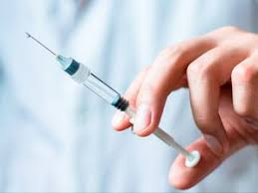
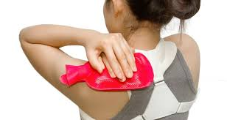
Chronic injury management
Corticosteroid injections
Heat Treatment: to increase blood flow relief pain increase flexibility

Slide 16
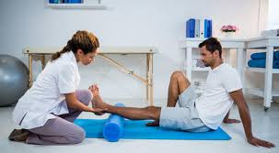
Chronic injury management
Physiotherapy: using massage, manipulation and special exercises to improve the range of motion and return the normal function of injured area Long-term injury can be treated with a program of walking and swimming to help strengthen the muscles in the affected body part.

Slide 34
